Slide 1
Fall IFAB 2013
WP5: Work package presentation
University of Skövde
20 Nov 2013
Notes:
Time budget: 10min (MAX)

Slide 2
WP5: Brief summary
Together with Volvo Car Corporation (VCC), and in collaboration with WP2, the work package has:
  analysed which visual presentations of uncertainty have been used for different aspects of uncertainty and different components of uncertainty management within assisted and autonomous driving (AD), particularly from an information fusion perspective
  designed, implemented and evaluated prototypes for presenting the vehicle’s uncertainty to the driver
  presented and published a co-authored conference article

Slide 3
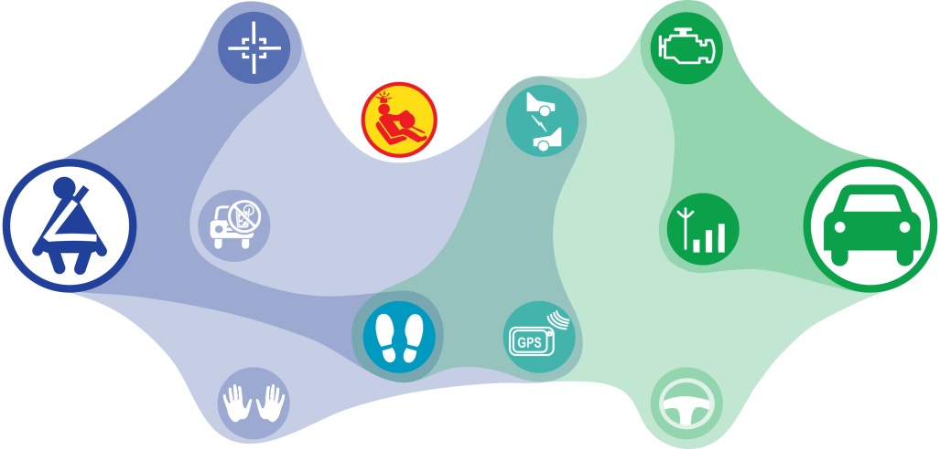
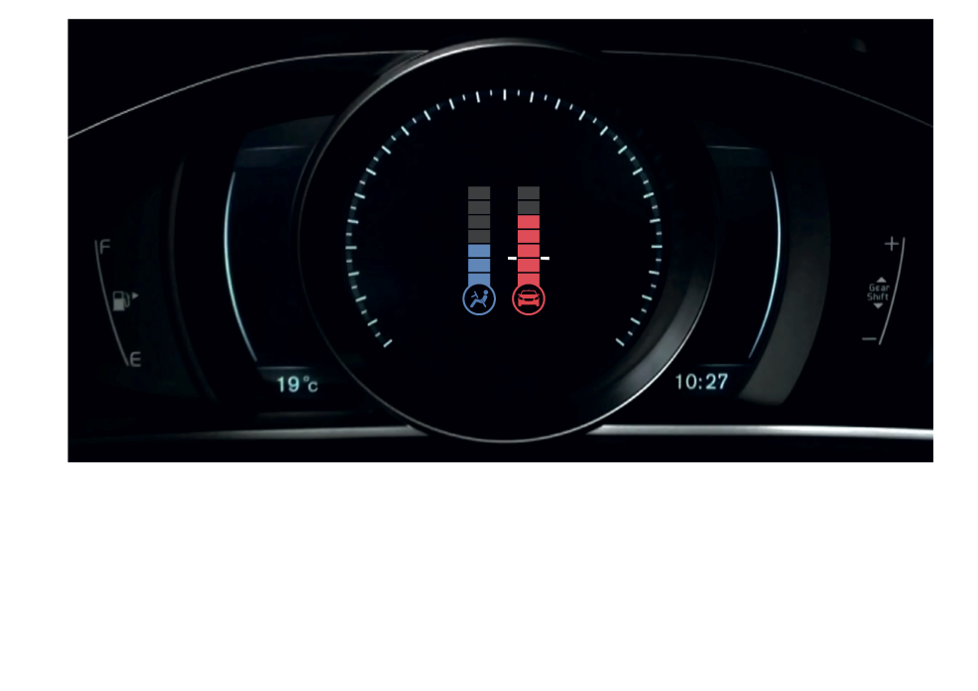
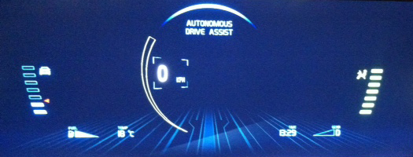
Technical achievement

Slide 4
Summary of results
Contribution to information fusion:
  Comprehensive literature study on the use of uncertainty visualization, uncertainty management and information fusion within Advanced Driving Assistance Systems (ADAS)
Contribution to AD and ADAS:
  Empirical results of how the presentation of the vehicle’s uncertainty affects driving behavior and drivers’ trust in ADAS
Contribution to information visualization:
  Evaluated designs and empirical results of how to visually present the uncertainty of an autonomous system to a human operator

Slide 5
Results compared to goals
Deliver guidelines for constructing effective combinations of presentations, aspects and components of uncertainty
  Not achieved (future work)
Deliver evaluated designs and empirical results of how to present the uncertainty of the vehicle and the combined uncertainty of the vehicle and the driver, respectively, to the driver
  Achieved
Deliver a journal publication on information fusion aspects of assisted and autonomous driving
  Not achieved
Deliver a journal publication on how uncertainty management can support human automation co-operation and improve driving performance and experience
  Not achieved (future work)

Slide 6
Detailed list of publications
Helldin, T., Falkman, G., Riveiro, M. and Davidsson, S. (2013). Presenting system uncertainty in automotive UIs for supporting trust calibration in autonomous driving.
In: Proceedings of the 5th International Conference on Automotive User Interfaces and Interactive Vehicular Applications (AutomotiveUI ’13), pp. 210–217. New York, NY, USA. ACM.

Slide 7
Future work/plans/directions
From the empirical results from the case study at VCC, compile guidelines for constructing effective combinations of presentations, aspects and components of uncertainty
Based on the conference publication and the literature study, write a journal article on how uncertainty management can support human automation co-operation and improve driving performance and experience

